Slide 1



Text Of Silence
a
Lip Reading Technique for helping aphonia patients

Slide 2






Supervisor
Dr : Mohmmed Abdelhamed
Team Members
Mamdoh Marof Abdulrazak
Mahmoud Mohamed Fouad
Amr Fatouh Abbas
Mohammed Awadallah Bakir
Abdelrahman Mohammed

Slide 3
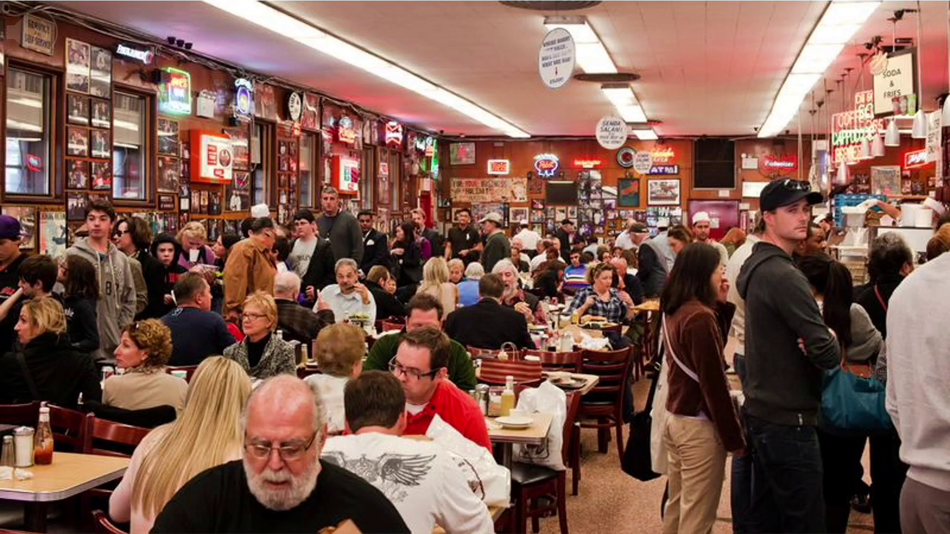
Noise Environments

Slide 4
It is difficult to hear others in noise environments but fortunately audio is not the only carrier of speech
problem
lip movement contains more enough information to know what is saying in the noise environments
For that, we construct the text of silence application to automate this process
solution

Slide 5

Aphonia

Slide 6

Aphonia
APHONIA
Aphonia is inability to produce sound
means "no sound". In other words, a person with this disorder has lost their voice.
Caused by
01 - injury
02 - surgery
03 - psychology :
Psychogenic aphonia is often seen in patients with underlying psychological problems.
Text of silence convert the lips movements of aphonia patients into text
What is aphonia?

Slide 7
T
O
S
Text
of
Silence
Seeing the lack of research in the field motivated us to explore how we can utilize our knowledge to implement a solution that could contribute to aiding the hearing-impaired.
The project is also relevant to our interests as it mainly involves two fields of computer engineering like Computer Vision, Neural Networks and Machine Learning in general and Neural Networks in specific.
Text of Silence is a lip-reading mobile application that aims to help the hearing-impaired and aphonia patients communicate and interact better with their surroundings.

Slide 8

Background On AI
To know how our project works we must first discuss what Artificial intelligence (AI) & ML and DL are :
AI
is a field of computer science that studies how machines can imitate the intelligence of their human counterparts.
Machine learning (ML) :
is a subset of artificial intelligence, which builds a mathematical model based on sample data, known as “training data,” to make predictions or decisions without being explicitly programmed to perform the task.
Deep Learning DL :
is an emerging field of Machine learning; that is, it is a subset of Machine Learning where learning happens from past examples or experiences with the help of ‘Artificial Neural Networks.

Slide 9
What do you already know about the LipReading?
The use of lip-reading has been documented since the 16th century and hearing-impaired people often use lip-reading as an adjunct to understanding fluent speech. When it comes to automating the process, there are many challenges compared to conventional audio recognition.
1 - Improved speaker independent lip-reading using speaker adaptive trainning and deep neural networks :
Deep Neural Networks (DNN) with different deep learning architectures have proved to be successful in Automatic Speech Recognition (ASR) . The first stage of training is Restricted Boltzman Machines (RBMs) to unsupervisedly learn a better representation of audio and visual features . The learned features are then passed to a deep autoencoder where training is supervised . They reported a classification improvement on AVletters and CUAVE when only visual features are available at supervised training and testing but both modalities are present at the feature learning stage . the use of a context-dependent DNN system on a single speaker dataset, gave a word accuracy of 85%.

Slide 10
What do you already know about the LipReading?
2 - Combining Residual Networks with LSTMs for Lipreading
We propose an end-to-end deep learning architecture for word-level visual speech recognition. The system is a combination of spatiotemporal convolutional, residual and bidirectional Long Short-Term Memory networks. We train and evaluate it on the Lipreading In-The-Wild benchmark. that have Accuracy with 68%.

Slide 11
01 TOS ?
02 Lip-Reading
03 TOS Benefits
04 System Architecture
CONTENTS
05 Risks and Constraints
Tos application
06 Domain Analysis
07 Requirments
08 DataSet
09 Sentence Structure
10 System Design
11 Diagrams
12 Techniques

Slide 12
Part 01
What is TOS?

Slide 13
TOS
TOS
is an application that uses the lipreading technique to help aphonia patients who can not produce sound from their mouths

Slide 14
Part 02
lip-reading?

Slide 15

01 What is lipreading ?
lip-reading
Lip reading, also known as speechreading, is a technique of understanding speech by visually interpreting the movements of the lips, face, and tongue when normal sound is not available. It relies also on information provided by the context, knowledge of the language, and any residual hearing. Although lip reading is used most extensively by deaf and hard-of-hearing people, most people with normal hearing process some speech information from the sight of the moving mouth.

Slide 16
Part 03
TOS Benefits?

Slide 17
Tos Benifits
aphonia
impired people
video calls
Silent dictation in public spaces
it can help these people to communicate and interact with the community naturally by having the patient take a video of him speaking so that the application can know what he is saying and turn it into a text that normal people can read
it can help these people to communicate and interact with the community naturally by filming a video of the people they are talking to so that people with hearing problems can understand what they are saying
in reading places like libraries or any public place you can't talk with sound so you can use our project.
In noisy environments, it's difficult to hear the sound of video hence you can generate speak from lip movements by our project.

Slide 18
Part 04
System Architecture

Slide 19
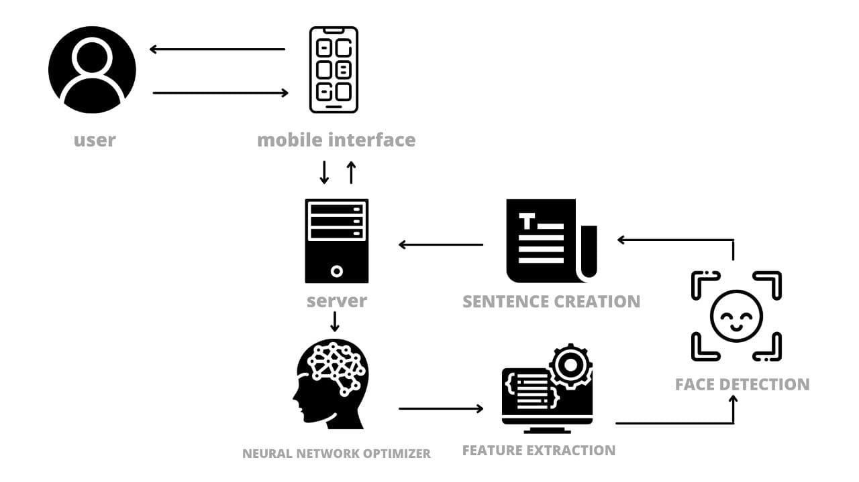
System Architecture

Slide 20
Part 04
Risks & Constrains

Slide 21

Problems
video quality
01
›
The main problem that we will face is the quality of video capture and the surrounding lighting in the shooting environment.
similar letters
02
›
And also the confusion that occurs when similar letters are pronounced in the movement of the mouth
data
03
›
There is also a major problem in implementing the project, which is the lack of enough data to be able to train the model so that it can find all the words wewant it to expect.

Slide 22
Part 05
Domain Analysis

Slide 23
TOS consists of
01 - lip-extracting module-using image processing
02 - a learning module using machine learning.
Description of Products and Services:
01 - build a system that captures human face, detects the mouth position and traces its movements regarding lips positions and movements in order to predict the words said or willing to be said by the user.
02 - Mobile camera captures the user’s video, passing it to a back-end where all the lips tracing will be processed by an already trained module to detect the desired word or group of words.
03 - The actual text then propagates to the user’s application interface.

Slide 24
Part 06
Requirments

Slide 25
Functional Requirments
01
02
03
04
05
A fully functional mobile app that controls workflow with servers, APIs, users, in organized, accurate, and quick methods.
A Server contains Machine Learning Models.
API to guarantee communication between server and application.
A fully functional and tested Machine Learning Model that analyzes lip movement to predict output text.
A system that specifies output text and generates an audio clip that helps user to communicate with other users.
06
07
08
take videos to generate text.
.The Application must forward the recorded video to the model for analysis and prediction text through an API
Web service to be used as a mobile app.

Slide 26
Non-Functional Requirments
The speed of video analysis and the speed of word prediction from the movement of the lips within seconds
A well-organized and managed system architecture that facilitates maintenance, restoration and scalability.
The system correctly predicts most words from videos
Fast APIs and retrieve data from servers within seconds.
01
02
03
04
05
06
A clear, attractive, responsive, less cluttered and efficient user interface that ensures a good user experience and handles a variety of tasks.
The application works on most versions of Android and IOS

Slide 27
Part 07
DataSet

Slide 28
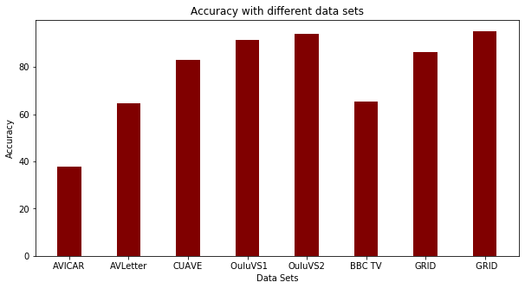
Dataset
data set | output | accuracy
AVICAR | Digits | 37.9%
AVLetter | Alphabet | 64.6%
CUAVE | Digits | 83.0%
OuluVS | Phrases | 91.4%
OuluVS2 | Phrases | 94.1%
BBC TV | Words | 65.4%
GRID | Words | 86.4%
GRID | Sentences | 95.2%

Slide 29
Grid Dataset
We use the GRID corpus to evaluate our project b ecause it is sentence-level and has the most data. The sentences are drawn from the following simple grammar: command + color+ preposition+ letter + digit+ adverb , where the number denotes how many word choices there are for each of the 6 word categories. The categories consist of, respectively, {bin, lay, place, set}, {blue, green, red, white}, {at, by, in, with}, {A, . . . , Z}\{W}, {zero, . . . , nine}, and {again, now, please, soon}, yielding 64000 possible sentences. For example, two sentences in the data are “set blue by A four please” and “place red at C zero again”.

Slide 30
Part 10
Sentense Structure

Slide 31
Sentence Structure
number
number
preposition
adverb
adverb
A number is a mathematical object used to count, measure, and label.
like : one , tow , three , ten
Adverbs are words that usually modify—that is, they limit or restrict the meaning of—verbs. They may also modify adjectives, other adverbs, phrases, or even entire sentences.
color
command
color
alphabet
alphabet
color is the visual perceptual property corresponding in humans to the categories called blue, green, red, etc.
like : a,c,f,t,j,i
command
preposition
When we want to tell someone to do something in English, we use a command.
A preposition is a word or group of words used before a noun, pronoun, or noun phrase to show direction, time, place, location, spatial relationships, or to introduce an object. Some examples of prepositions are words like "in," "at," "on," "of," and "to."

Slide 32
Part 12
System Design

Slide 33

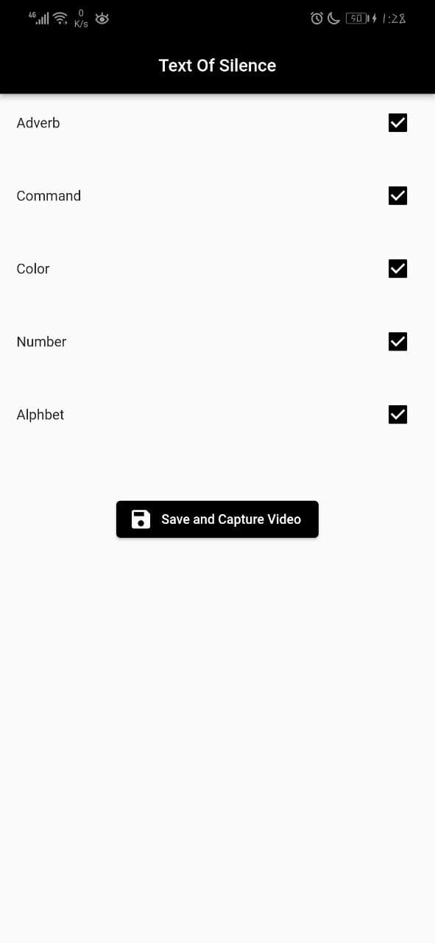
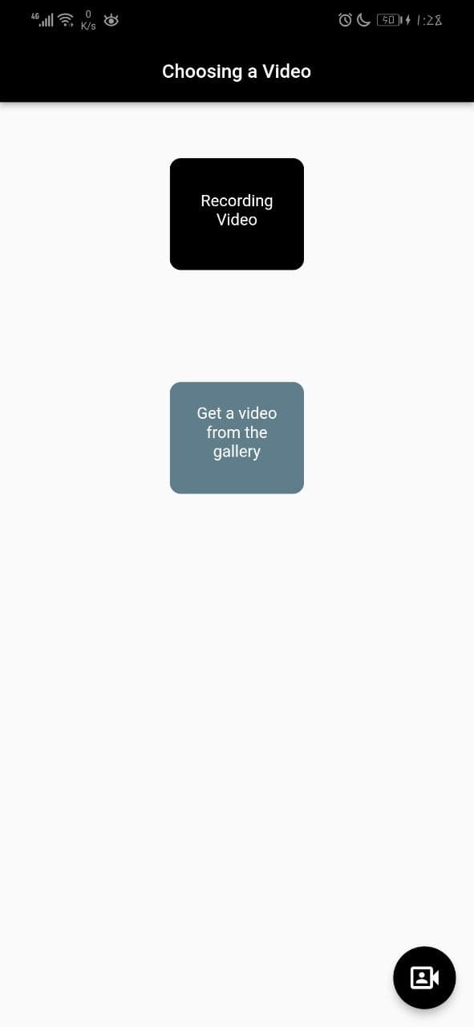
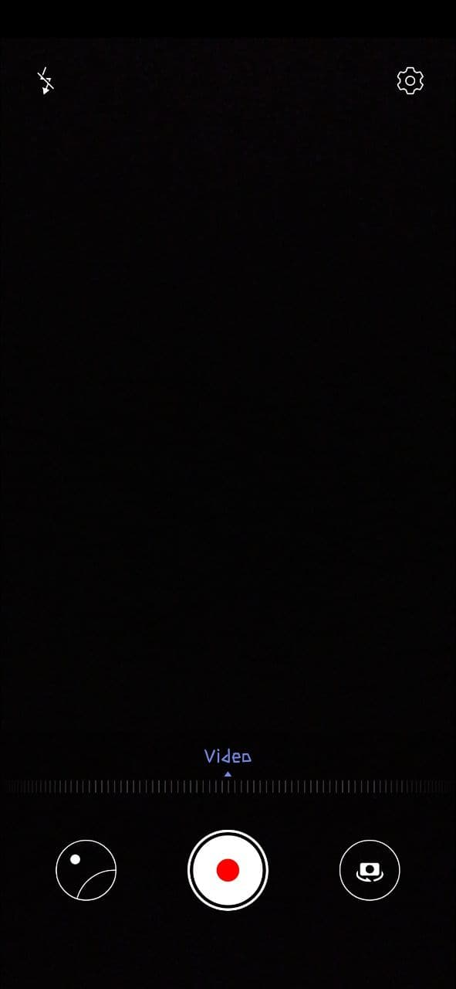
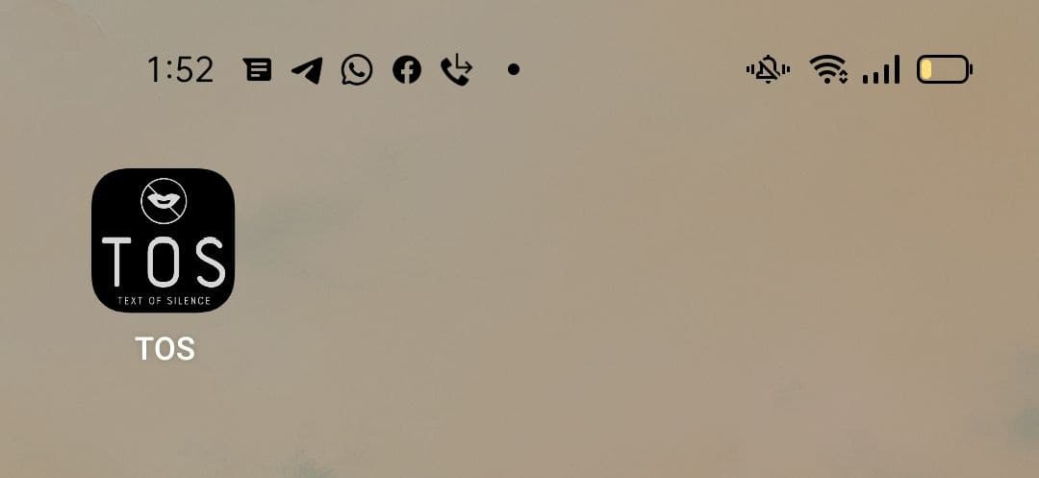
Interfaces
Welcome Page
Sentence Structure
Video Type
Record video
Application Icon

Slide 34
Part 07
Diagrams

Slide 35
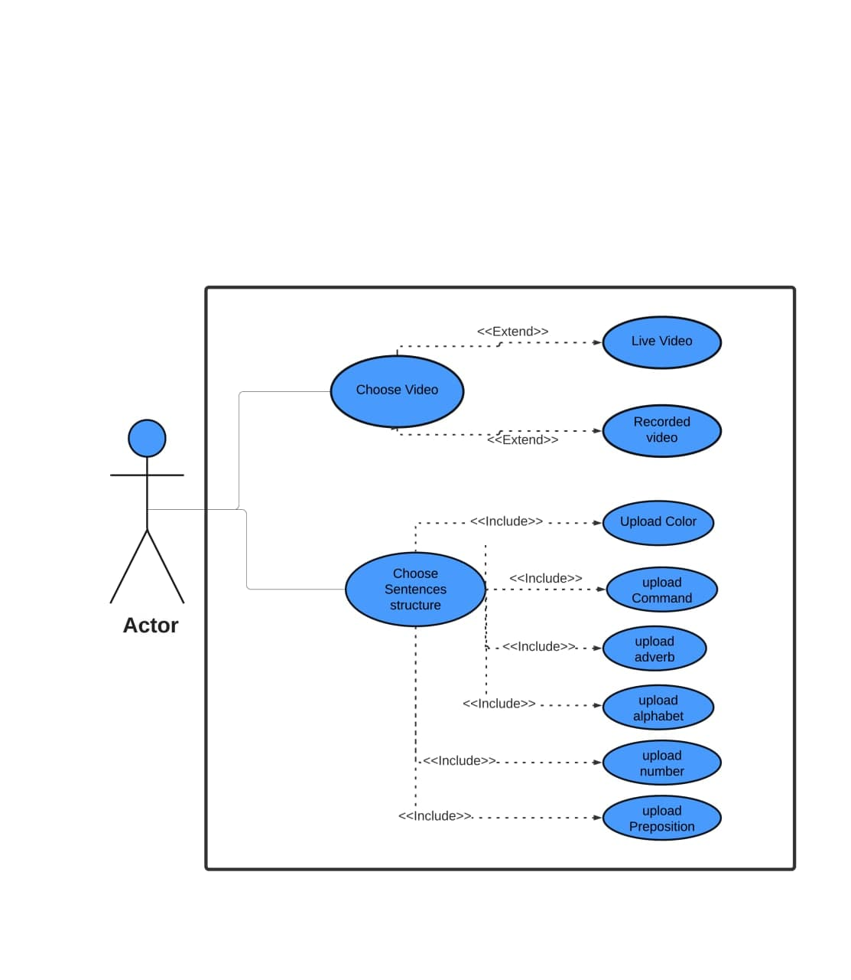
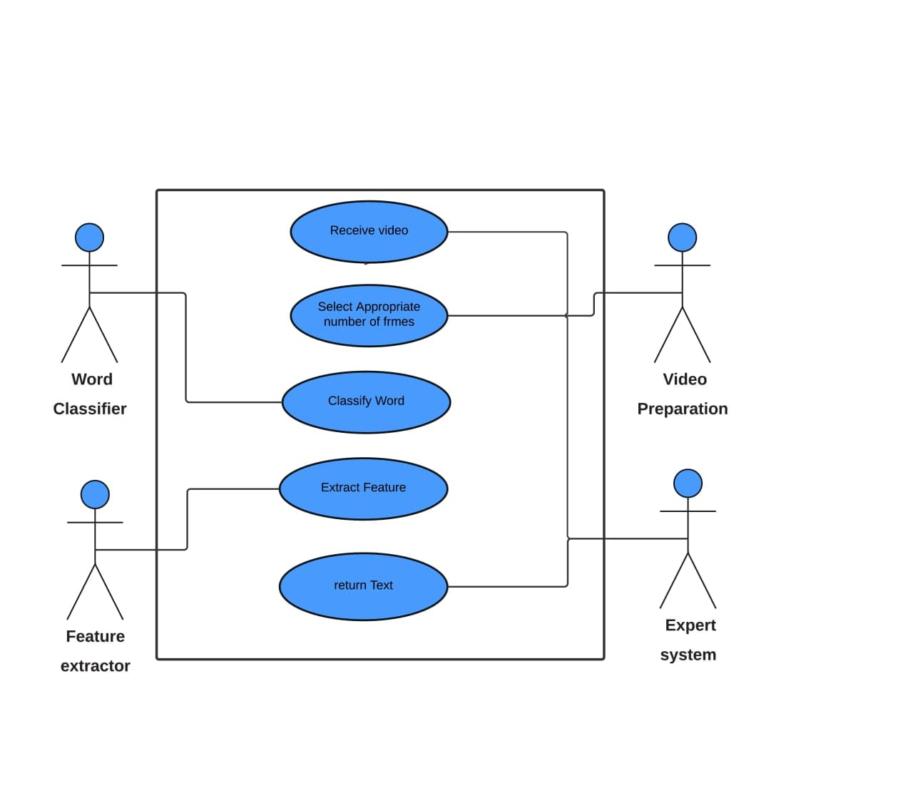
Diagrams
usecase application
usecase server

Slide 36
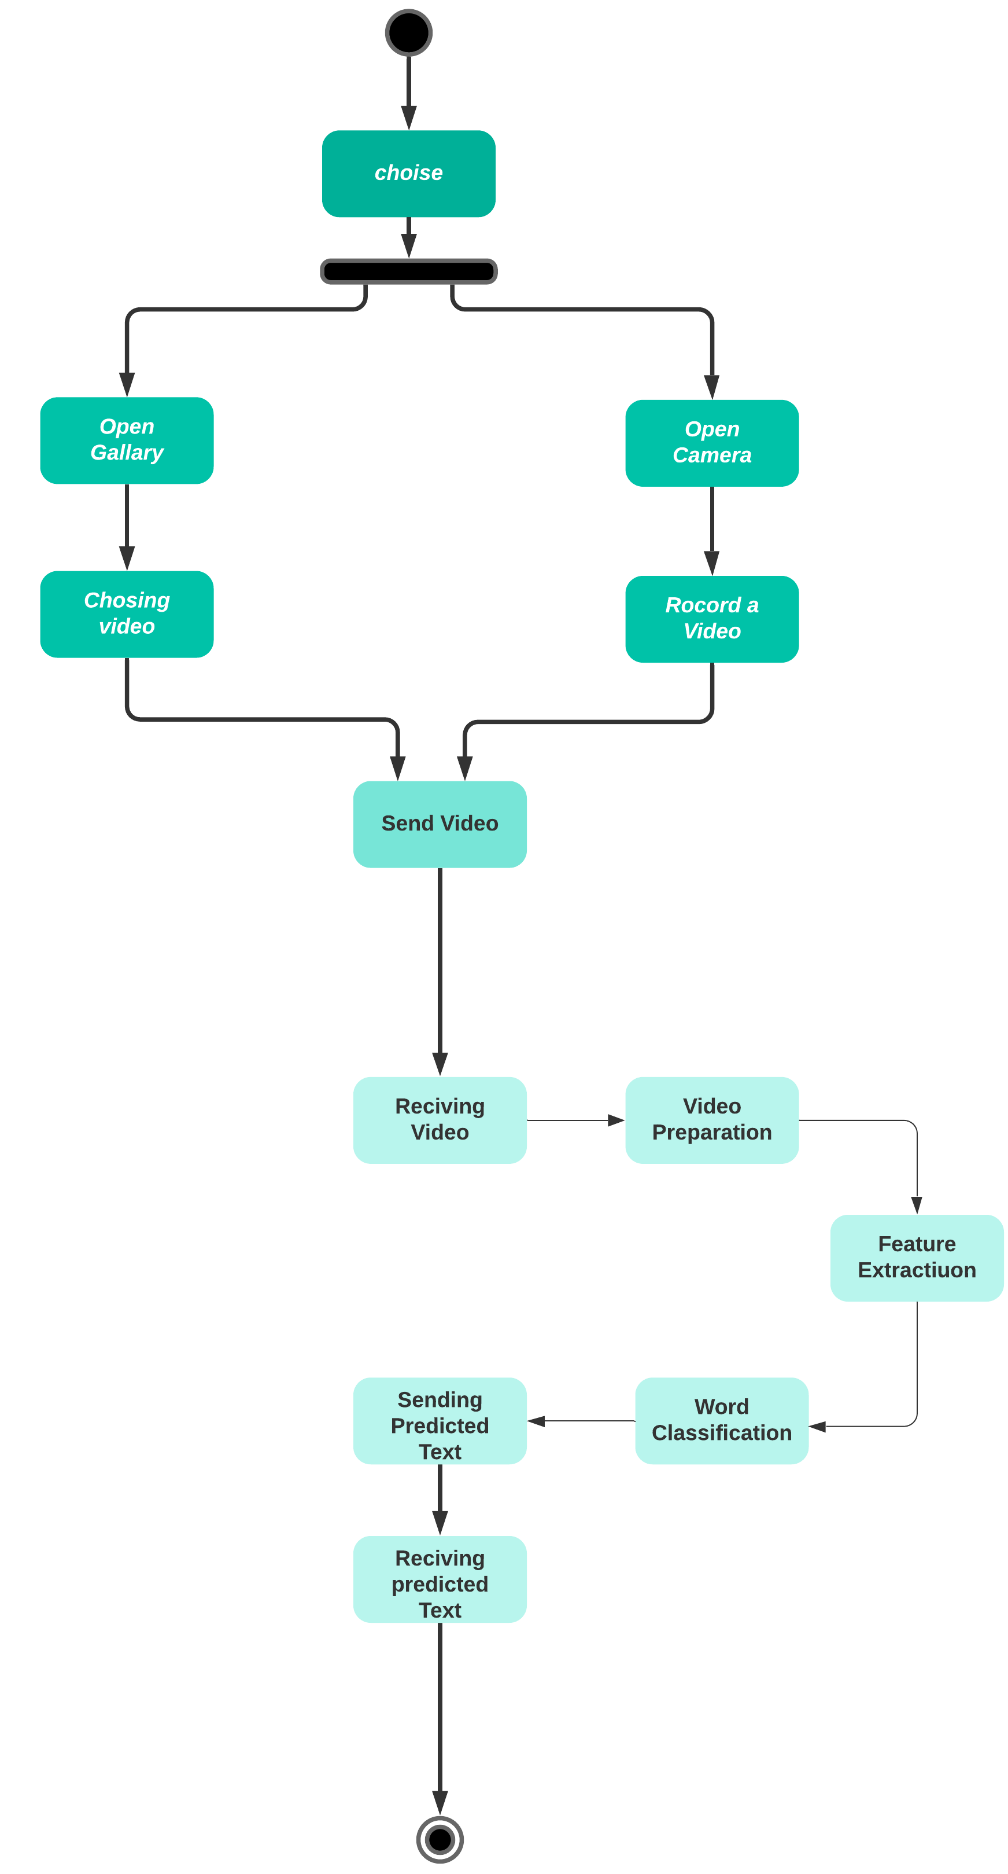
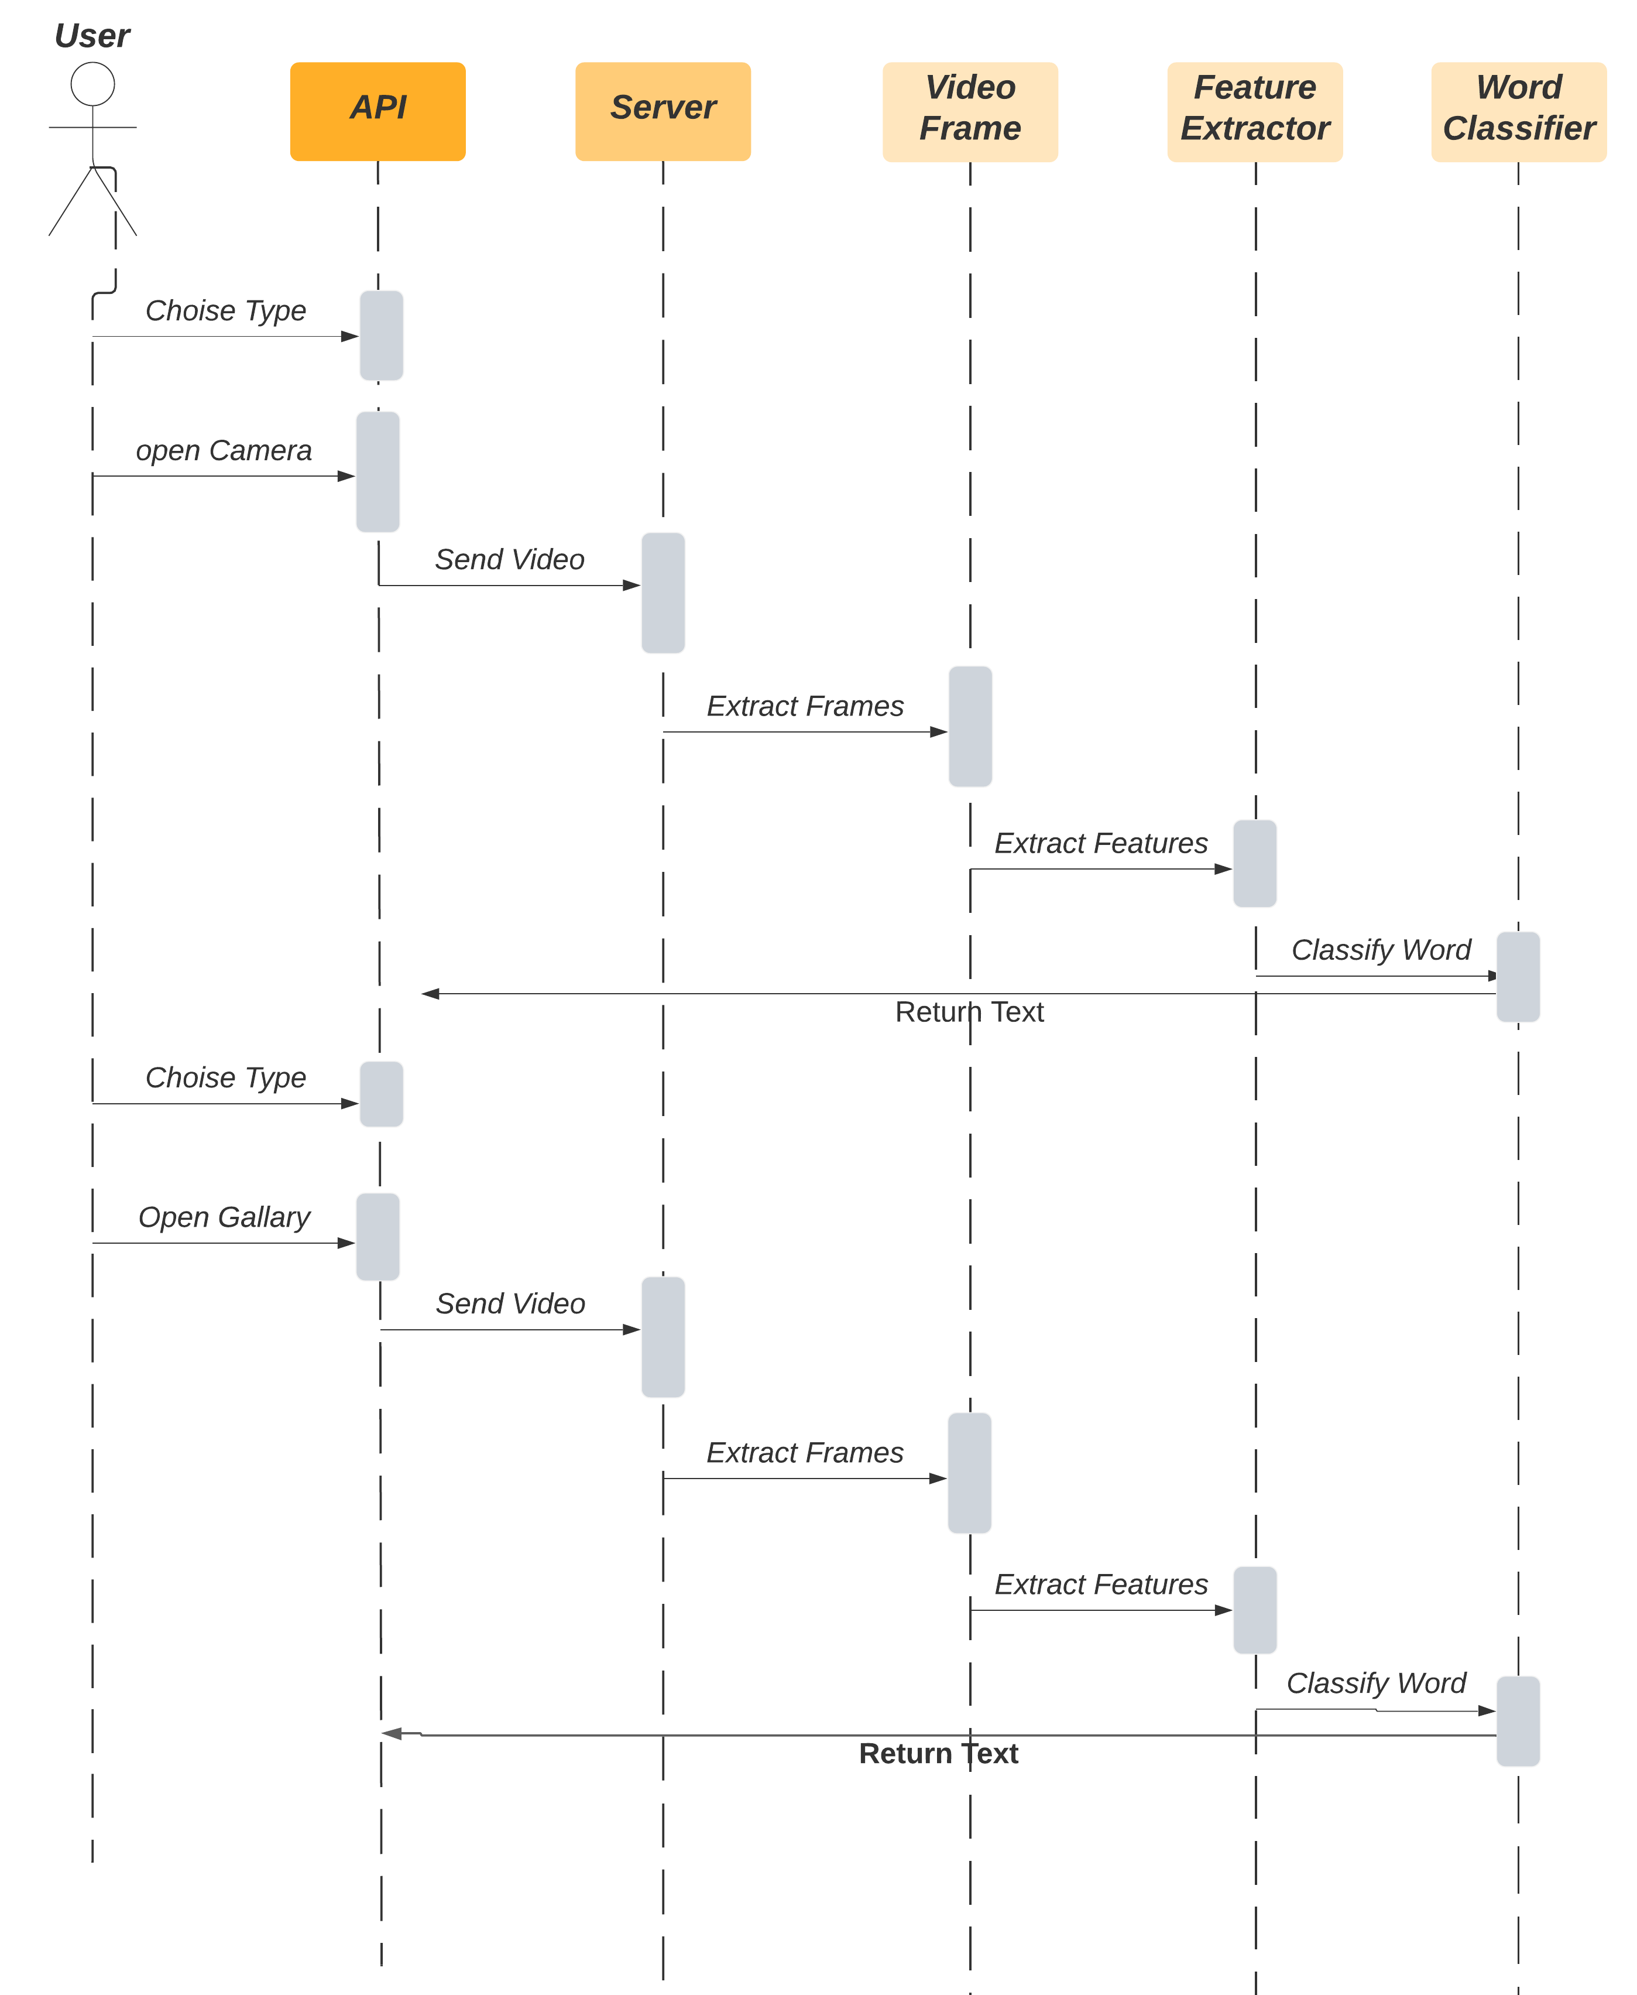
Diagrams
Sequence diagram
State Diagram

Slide 37
Part 07
Techniques

Slide 38

Techniques
Adaptive Moment Estimation is an algorithm for optimization technique for gradient descent. The method is really efficient when working with large problem involving a lot of data or parameters. It requires less memory and is efficient. Intuitively, it is a combination of the ‘gradient descent with momentum’ algorithm and the ‘RMSP’ algorithm
in deep learning, a convolutional neural network (CNN)is a class of artificial neural network, most commonly applied to analyze visual imagery.
CNN
Adama optimizer
recurrent neural network (RNN) is a class of artificial neural networks where connections between nodes form a directed or undirected graph along a temporal sequence. RNNs can use their internal state (memory) to process variable length sequences of inputs.This makes them applicable to tasks such as unsegmented, connected handwriting recognition or speech recognition.
Artificial neural networks (ANNs), usually simply called neural networks (NNs), are computing systems inspired by the biological neural networks that constitute animal brains.
ANN
RNN

Slide 39
Techniques
CNN
RNN
Receiving frames from video preparation process and returning
feature vector
Classifiy the word
video
video preparation
ANN
Converts the video preparation to the appropriate number of frames
and sends it to the feature extraction process
Classifiy the word

Slide 40
Thank you

